Slide 1
Blind man reading machine

Slide 2
CATEGORY
APPLIANCE DESIGN

Slide 3
PROJECT BY:
Aman Shukla
Aryamick Singh
Nitin Vinayak Agrawal
Sarthak Baral
Shantanu Nigam

Slide 4
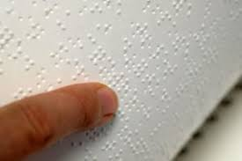
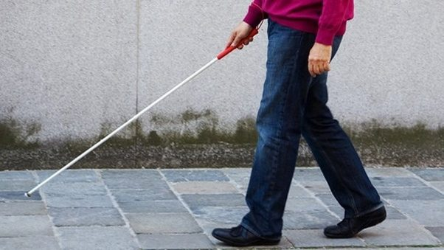
15 million blind people in India
37 million blind people across globe

Slide 5
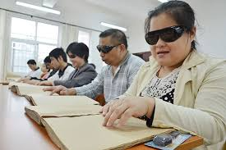
No commercially available product to help them read
News papers
can not be
printed in braille,
nor can every
book in market.

Slide 6

So what is the solution ?

Slide 7
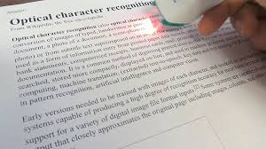
A simple dedicated device which uses OCR to read text and give audio output to the person.

Slide 8

With the help of this device, the person can read any text, with just a click of a button

Slide 9

With the current development in the field of electronics, total negligence of a certain section of people is not justified when it is possible to cure their problem easily.

Slide 10
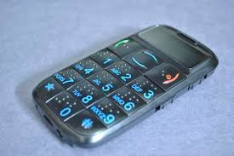
There may exist other solution for the problem like mobile app or special mobiles meant for the blinds.
But the problem arises…..

Slide 11
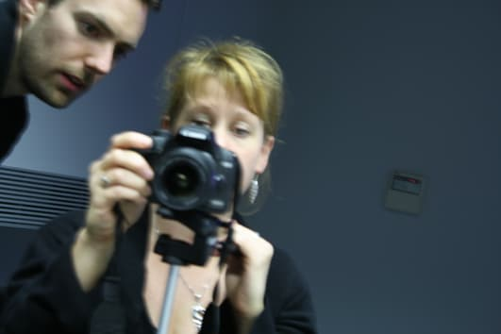
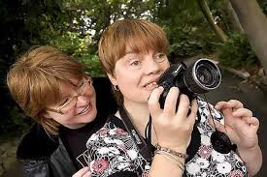
How can a blind man precisely click a photo?

Slide 12
With our dedicated device, the blind person can align the page and just press the button, rest all is done.
No need to focus on something you can’t see.

Slide 13

The prototype when goes into mass production will cost nearly 3000 ₹
At this cheap price, the person gets to read all the books, newspapers, letters and what not.
It is of course not like getting eyes back, but it is a great help to them anyhow.

Slide 14
Thank you

